Slide 1
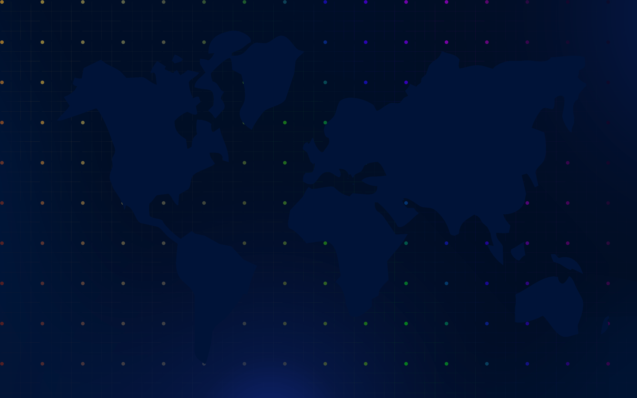
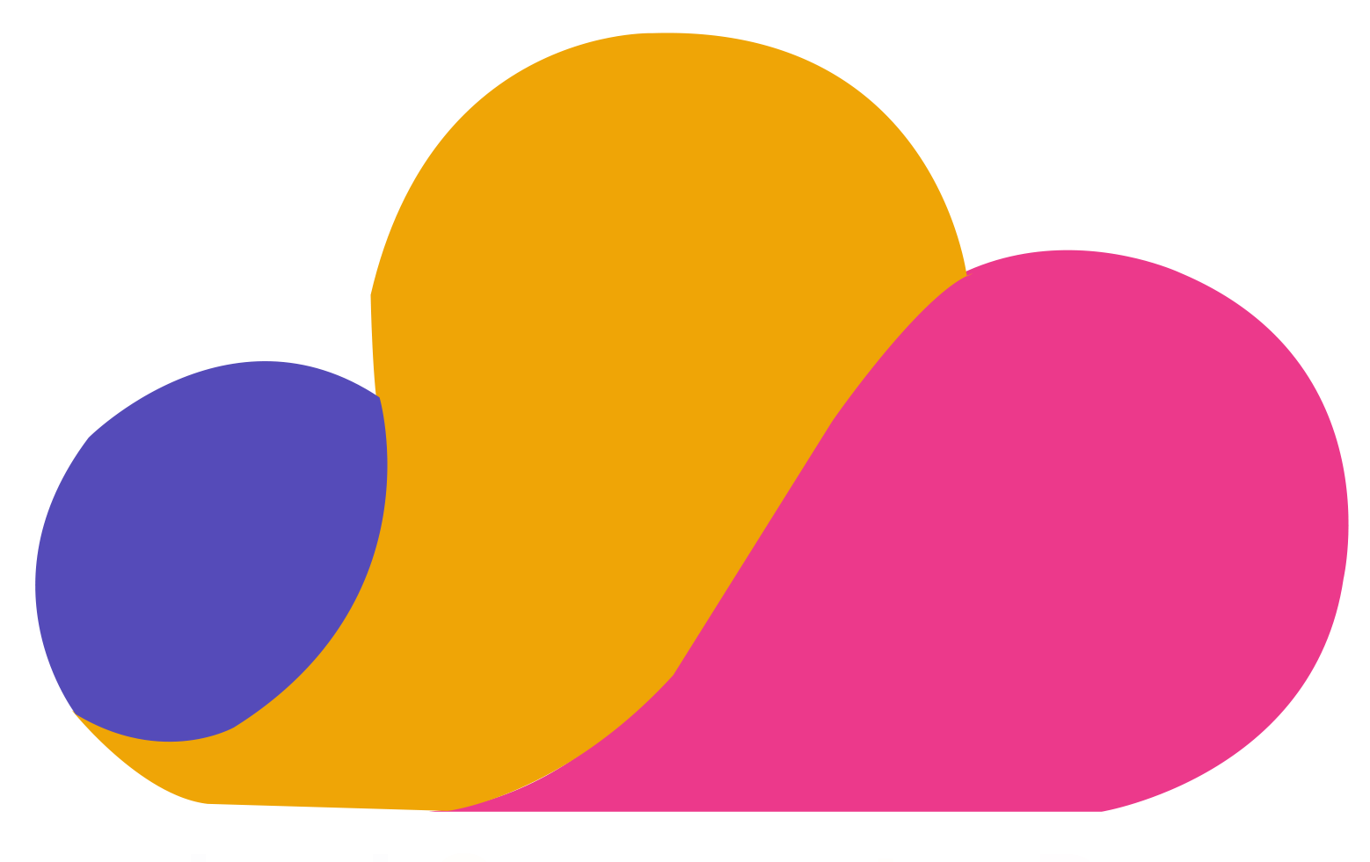


Containerize Microservices with Service Fabric
#CCDaysOnline
Hamida REBAI – Microsoft MVP – Architect
@rebaihamida
didourebai@gmail.com

Slide 2

Agenda
Microservices Overview
Introduction to Service Fabric and architecture
Prepare the environment
Demo

Slide 3
Digital transformation and business needs
Faster delivery of features.
Hight availability of services
Prepare a qualitative model for estimating migration costs.
Perform the migration by limiting the impacts on the company

Slide 4
Monolithic vs Microservices Architecture

Slide 5
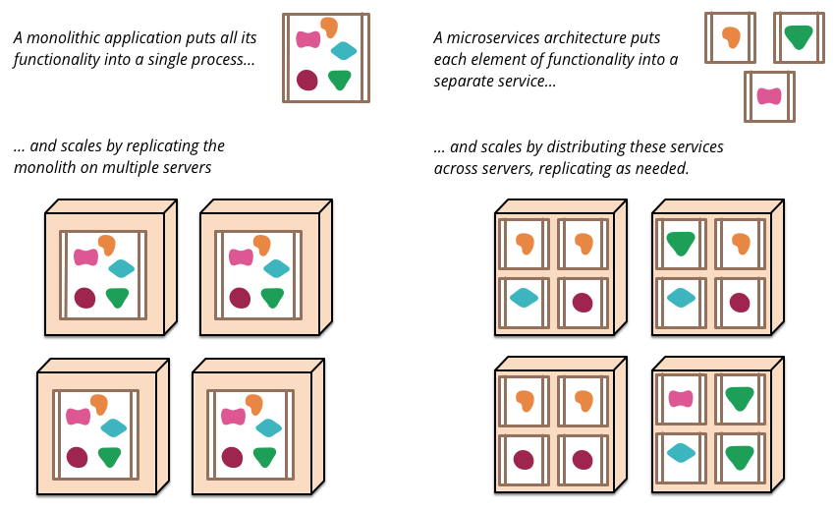
https://martinfowler.com/articles/microservices.html

Slide 6


Slide 7


Slide 8

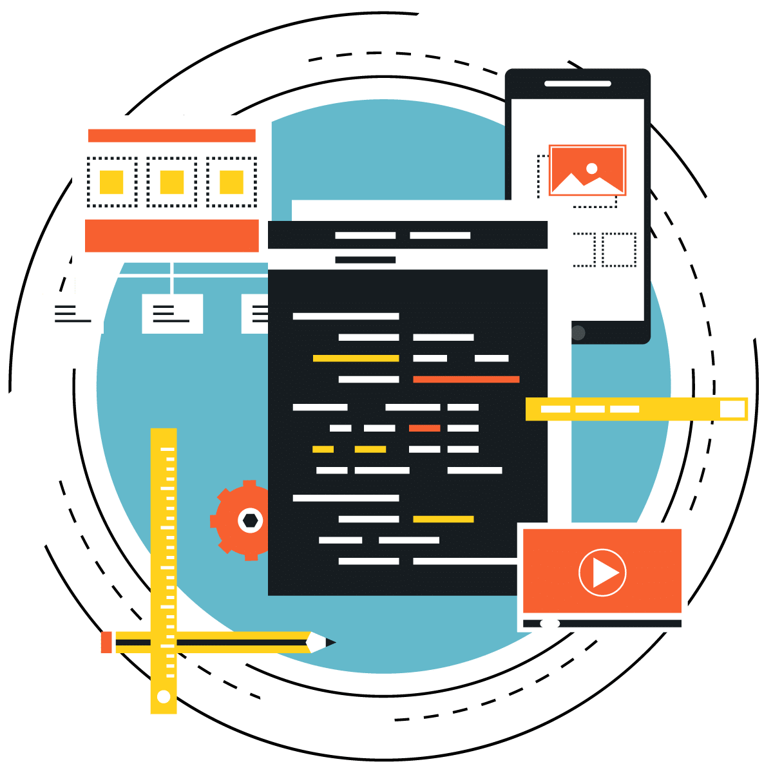


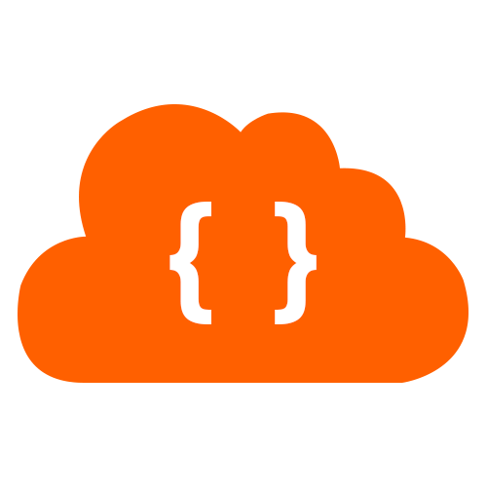



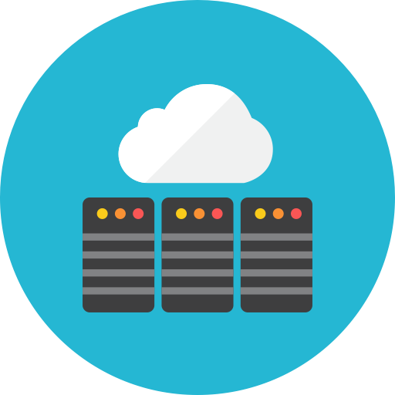



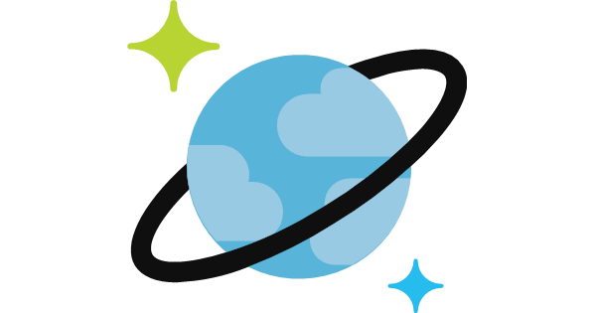
Monolithic application approach
Microservices application approach
Presentation Layer
Desktop & Mobile
apps
Web apps
Services tier
API Gateway
Business logic Layer
Microservices
SQL DB
or
No-SQL
SQL
[…]
No-SQL
[…]
Stateful service
Database access Layer
Monolithic Databases are shared across services.
Each microservice owns its model/data!

Slide 9
Benefits of Microservices
Microservices allow to evolve, deploy and scale parts of the application independently.
Microservices offer great distributed software challenges.
Microservices is for large, scalable and long-term evolving applications.

Slide 10
Microservices architecture and Patterns

Slide 11
Patterns | Technologies
Microservices
Docker Containers
Autonomous
Bounded Context
Linux Containers
Docker Image
Nomad & addressable services
Isolated
Docker Host
API Gateway
Windows Containers
Docker Registry
Decoupled
Docker Hub
Events
Async. communication
Hyper-V Containers
Event Bus
Message Brokers
Azure Service Bus
Azure Container Registry
Service Discovery
Health Checks
Orchestrators
Transient Failures Handling
Resiliency
Azure Service Fabric
Stateful Services
Commands
Actors
Retries with Exponential Backoff
Azure Container Service
Domain-Driven Design
Circuit Breakers
RabbitMQ
CQRS simplified
Kubernetes
NServiceBus
Aggregates
Docker Swarm
MassTransit
Domain Entity
Domain Events
Mesos DC/OS
Brighter
Mediator
Polly

Slide 12

Challenges building cloud applications
Focusing on business logic instead of microservice platform maintenance
Optimizing for microservice development
</>
.NET
Monitoring and governance at overarching and granular levels
Running highly secure applications at scale
Dealing with the complexity of network communications
Achieving reliable state and data consistency without latency issues
</>
Tracking multiple deployment pipelines while maintaining agile updates

Slide 13
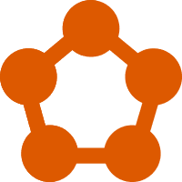
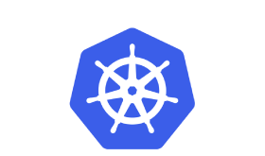
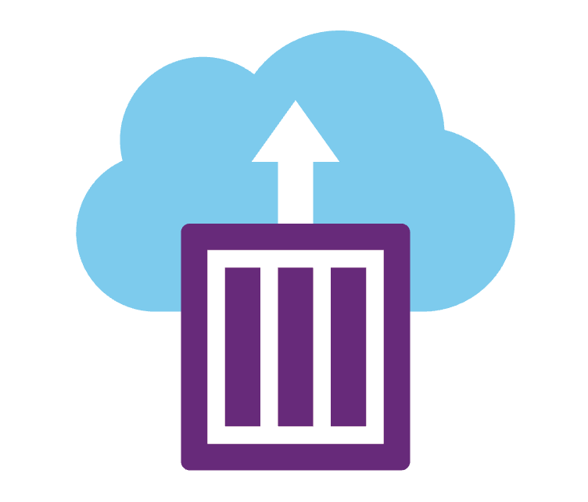


Containers in Azure: a complete Set of Choices
App Service
Service Fabric
Kubernetes Service
Container Instances
Batch
Notes:
Azure provides different choices for app modernization

Slide 14
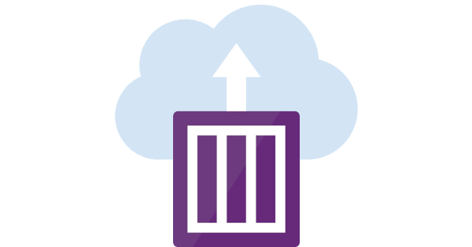

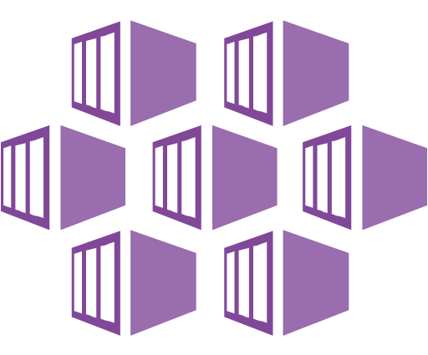

PaaS vs CaaS vs FaaS
1
2
3
PaaS et CaaS
Azure Service Fabric
Azure Service Fabric Mesh
CaaS
Azure Container Instance
Azure Kubernetes
FaaS
Azure Functions

Slide 15



Service Fabric overview
Service Fabric is a large-scale microservices execution platform
Azure Service Fabric is a Microsoft PaaS
Service Fabric is a distributed systems platform
Service Fabric is not only an Orchestrator for Container
Service Fabric can be deployed on Azure or AWS or OpenStack

Slide 16
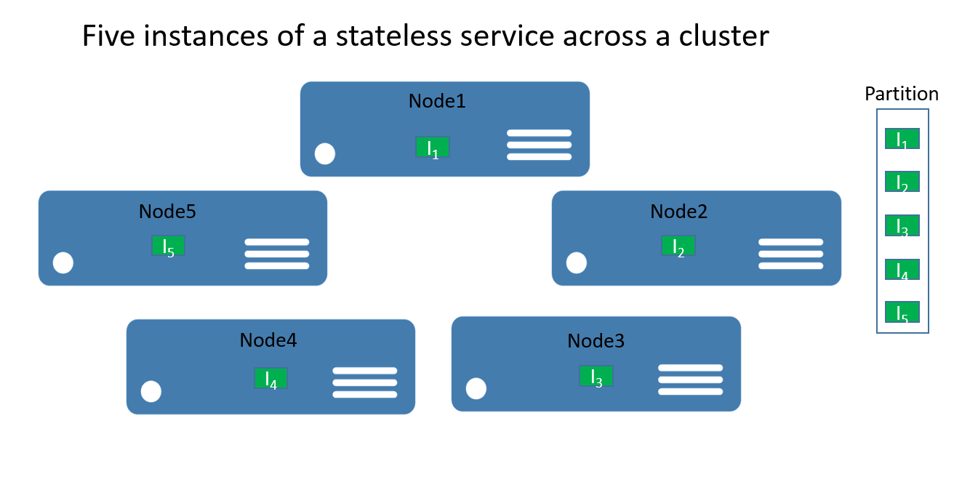
Service Fabric Cluster structure
Service Fabric cluster: a network-connected set of virtual machines (VMs) into which your microservices are deployed and managed.
The nodes are the VMs that belong to the Service Fabric cluster.
Notes:
We will see how we can create a local service fabric cluster using SDK service, this cluster will allow us to create service fabric application using Visual Studio and deploy it locally after we will deploy on Service Fabric cluster in Microsfot Azure.
Service Fabric cluster: a network-connected set of virtual machines (VMs) into which your microservices are deployed and managed.
A cluster is a set of nodes that are VMs, node numbers depends from the use of clusters, in development phase, one node is used but in production, you need to have more than 5.
Every node has an operating system windows or linux with a runtime. A node can host multiples applications it depend from the resource available in the virtual machine.

Slide 17


Azure Service Fabric
Build and deploy containers and microservices on Windows and Linux, at any scale, on any cloud
Build
Deploy
Operate
</>
.NET
</>
Flexible infrastructure
Lifecycle management
24/7 availability & performance
Elastic scalability
Microservice and container orchestration
Security & compliance
Health & monitoring
Challenges
Dealing with the complexity of interactions and network communications
Optimizing for microservice development
Tracking multiple deployment pipelines while maintaining agile updates
Monitoring and governance at overarching and granular levels
Achieving reliable state and data consistency without latency issues
Focusing on business logic instead of microservice platform maintenance
Running highly secure applications at scale

Slide 18

Service Fabric: cloud application platform
Build and deploy containers and microservices on Windows and Linux, at any scale, on any cloud
Build
Deploy
Operate
Programming Models
Dev & Ops Tooling
Orchestration
Lifecycle Management
Health &
Monitoring
Always On Availability
Auto
Scaling
Dev machine
Any cloud
On-premises infrastructure
Azure

Slide 19


Azure Service Fabric offerings
Dev machine
Any cloud
On-premises
Service Fabric Standalone
Azure
Service Fabric
Azure
Service Fabric Mesh
Bring your own infrastructure
Dedicated Azure clusters
Serverless microservices
Full Control
Fully managed
Service Fabric

Slide 20
Azure Service Fabric offerings
Dev machine
Any cloud
On-premises
Service Fabric Standalone
Azure
Service Fabric
Azure
Service Fabric Mesh
Bring your own infrastructure
Dedicated Azure clusters
Serverless microservices
Hardware
OS patching
Runtime upgrades
Cluster capacity
Network and storage
App deployment
You
Cluster capacity
Network and storage
App deployment
Responsibility
App deployment
Virtual machines
OS patching
Runtime upgrades
Virtual machines
OS patching
Runtime upgrades
Capacity planning
Network and storage
Micro-billing
Azure

Slide 21











Powering Azure and Microsoft services
Azure Service Fabric is designed for mission-critical services
Azure Database for MySQL
SQL Database
Power BI
Cosmos DB
Azure Monitor
Azure Database for PostgreSQL
Core Azure Services
Azure Container Registry
Dynamics365
IoT Hub
Intune
Event Hub
Archive Storage
Event Grid
Cortana
Skype for business
Visual Studio Team Services
Stream Analytics
Notes:
Azure Service Fabric is an open source project and is used in many services in Azure infrastructure as well as other Microsoft services, including Azure Event Hubs, Azure Cosmos DB, Azure SQL DB, Dynamic 365 and Cortana. The major sub-sections of Service Fabric can be seen below.

Slide 22
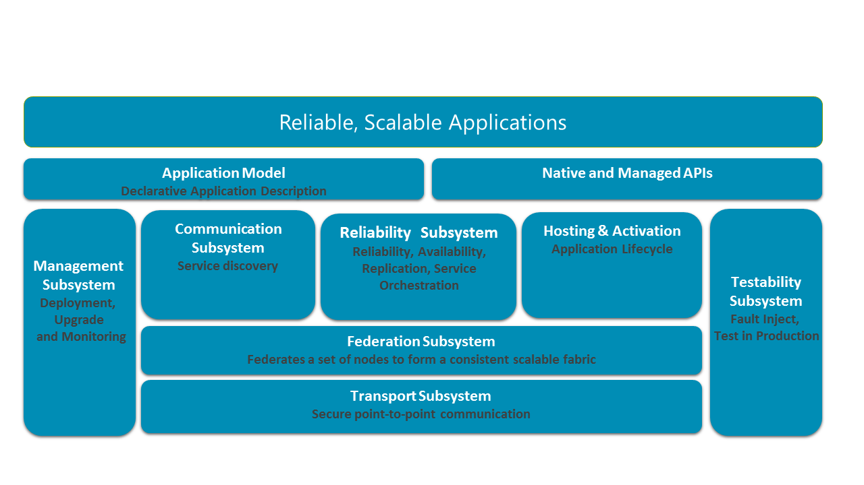
Service Fabric architecture
Notes:
Service Fabric is a platform that makes it easier to build and deploy microservices-based applications, handling both stateful and stateless operations. It will run on any Windows system and there’s also a Linux version, which means that it’s portable across multiple cloud environments including Amazon Web Services, OpenStack and VMware.
Apps that are created in the Azure Service Fabric environment are made up of granular microservices, small chunks of code which are uploaded and run separately. These microservices communicate with each other using service application-programming interfaces (APIs). Because microservices are modular, it’s possible to scale each component of an app separately which simplifies the process of rolling out changes, in contrast to traditional monolithic architecture.
Service Fabric provides lifecycle management capabilities to microservice based applications. The microservices are hosted inside containers that are deployed across the Service Fabric cluster. Using containers instead of virtual machines means a massive increase in density and greater still density can be achieved by moving from containers to microservices in these containers. For instance, a single cluster for Azure SQL Database is made up of hundreds of machines running tens of thousands of containers that in turn host hundreds of thousands of databases. Each database is a Service Fabric stateful microservice.
Subsystems of Service Fabric
The first layer from the bottom, the Transport Subsystem is responsible for providing secure communication channels between nodes in a Service Fabric cluster. The Federation Subsystem above it helps logically group physical or virtual nodes into a cluster so that it can be managed as a unit. This helps Service Fabric with tasks such as failure detection, leader election, and routing. Reliability of the workload hosted on Service Fabric is managed by the Reliability Subsystem. It owns the responsibility of replication, resource management, and failover. The Hosting & Activation Subsystem manages the lifecycle of the workload on every node and the Management Subsystem is responsible for managing the lifecycle of applications. The Testability Subsystem helps developers test their workload before and after deployment. Service location of services hosted on Service Fabric is managed by Communication Subsystem. The top three boxes capture the application programming models and the application model available for the developers to consume. More about application models is discussed in later parts of this book.
Transport Subsystem
The Transport Subsystem provides a communication channel for intra and inter cluster communication. The channels used for communication are secured by X509 certificate or Windows security. The subsystem supports both one-way and request-response communication patterns. These channels are in turn used by the Federation Subsystem for broadcast and multicast messaging. This subsystem is internal to Service Fabric and cannot be directly used by the developers for application programming.
Federation Subsystem
Federation Subsystem is responsible for logically grouping virtual or physical machines together to form a Service Fabric cluster. This subsystem uses the communication infrastructure provided by the Transport Subsystem to achieve this grouping. Grouping of nodes helps Service Fabric better manage the resources. The key responsibilities of this subsystem includes failure detection, leader election, and routing. The subsystem forms a ring topology over the nodes allocated for the cluster. A token-leasing mechanism along with a heartbeat check is implemented within the system to detect failures, perform leader election, and to achieve consistent routing.
Reliability Subsystem
Reliability of the service hosted on the platform is ensured by the Reliability Subsystem. It achieves these tasks by managing failover, replicating, and balancing resources across nodes in a cluster.
The replicator logic within this subsystem is responsible for replicating the state across multiple instances of a service. Maintaining consistency between the primary and the secondary replicas in a service deployment is its main task. It interacts with the failover unit and the reconfiguration agent to understand what needs to be replicated.
Any changes in the number of nodes in the cluster trigger the failover manager service. This in turn triggers automatic redistribution of services across the active nodes.
The resource manager plays the part of placing service replicas across different failure domains. It is also responsible for balancing the resources across the available nodes in the cluster while optimizing the load distribution and resource consumption.
Management Subsystem
The application lifecycle management of workloads deployed on a Service Fabric cluster is owned by the Management Subsystem. Application developers can access the Management Subsystem functionalities through administrative APIs or PowerShell cmdlets to provision, deploy, upgrade, or de-provision applications. All these operations can be performed without any downtime. The Management Subsystem has three key components – cluster manager, health manager, and image store.
The cluster manager interacts with the failover manager and the resource manager in the Reliability Subsystem for deploying the applications of available nodes considering the placement constraints. It is responsible for the lifecycle of the application, starting from provisioning to de-provisioning. It also integrates with the health manager to perform health checks during service upgrades.
Health manager, as the name suggests, is responsible for monitoring the health of applications, services, nodes, partitions, and replicas. It is also responsible for aggregating the health status and storing it in a centralized health store. APIs are exposed out of this system to query health events to perform corrective actions. The APIs can either return raw events or aggregated health data for a specific cluster resource.
The image store is responsible for persisting and distributing application binaries deployed on a Service Fabric cluster.
Hosting subsystem
The Hosting Subsystem takes care of managing application deployments within the scope of a node. The cluster manager signals the Hosting Subsystem, informing it about the application deployments to be managed on a particular node. The Hosting Subsystem then manages the lifecycle of the application on that node. It interacts with the Reliability Subsystem and Management Subsystem to ensure the health of each deployment.
Communication subsystem
The communication subsystem provides features for service discovery and intra-cluster messaging features using a naming service. The naming service is used to locate a service within a cluster. It also lets users securely communicate with any node on a cluster, retrieve service metadata, and manage service properties. The naming service also exposes APIs, which enables users to resolve network location or each service despite of them being dynamically placed.
Testability Subsystem
The Testability Subsystem provides a list of tools for developers, deployment engineers, and testers to introduce controlled faults and run test scenarios to validate state transitions and behaviors of services deployed on Service Fabric. The fault analysis service is automatically started when a cluster is provisioned. When a fault action or test scenario is initiated, a command is sent to the fault analysis service to run the fault action or test scenario.

Slide 23
Overview Monitoring and diagnostics

Slide 24
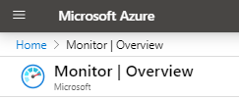

Monitoring and diagnostics
Application monitoring
Cluster monitoring
Infrastructure monitoring
Watchdogs
Azure Service Fabric
Explorer
Azure Monitoring
Notes:
Monitoring and diagnostics are critical to developing, testing, and deploying workloads in any cloud environment. For example, you can track how your applications are used, the actions taken by the Service Fabric platform, your resource utilization with performance counters, and the overall health of your cluster. You can use this information to diagnose and correct issues, and prevent them from occurring in the future.
https://docs.microsoft.com/en-us/azure/service-fabric/service-fabric-best-practices-monitoring

Slide 25


Prerequisites Environment
Windows 10 is required for Docker installation.
Visual Studio 2019 or 2017 has built-in support for Docker
.NET Core SDK
SDK Microsoft Service Fabric
Docker for Windows (optional)
Docker Tools(optional)

Slide 26
Set up your windows development environment to buid Service Fabric

Slide 27
Let’s start …
Install Visual Studio 2019
To use Visual Studio 2017 or 2019
Install the Microsoft Azure Service Fabric SDK
To use Visual Studio 2015 (requires Visual Studio 2015 Update 2 or later)
Install the Microsoft Azure Service Fabric SDK and Tools
SDK installation only
If you only need the SDK, you can install this package:
Install the Microsoft Azure Service Fabric SDK
Notes:
Service Fabric is a container orchestrator for deploying microservices across a cluster of machines. To run Windows container applications on your local development cluster, you must first install Docker for Windows. Get Docker CE for Windows (stable). After installing and starting Docker, right-click on the tray icon and select Switch to Windows containers. This step is required to run Docker images based on Windows.

Slide 28
Set up a local service Fabric Cluster

Slide 29
Create a Service Fabric using Visual Studio

Slide 30
Publish a Service Fabric in Visual Studio

Slide 31
Build a .NET Service Fabric application

Slide 32
Deploy a Service Fabric application to a cluster in Azure

Slide 33
Execute Docker container in Service Fabric

Slide 34
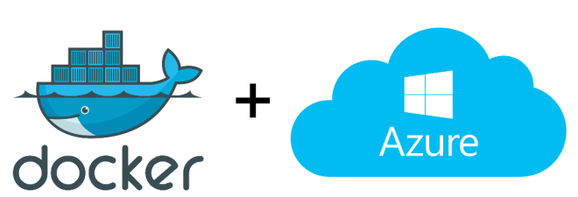
Docker container
Notes:
Docker is a tool that makes it easier to create, deploy, and run applications by using a containerization approach. These containers are lightweight and take less time to start than traditional servers. These containers also increase performance and lower cost, while offering proper resource management. Another benefit to using Docker is that you no longer need to pre-allocate RAM to each container.

Slide 35



Containers
<On-premises>
<Re-host>
<re-factoring>
<Re-architecting>
App
Container
Container
App
App
Binaries & Libraries
Container
Container
Guest VM
OS
App
App
Existing or New Apps
Lift and shift to containers
Microservices
Notes:
If we come back to our 5R for containers, we can see how we can deploy if we want to rehost, or refactor and the microservice approach if we decide to rearchitect and for new application we have to build patterns to adopt cloud native strategy in the future.

Slide 36
Build and execute Docker container in Service Fabric

Slide 37
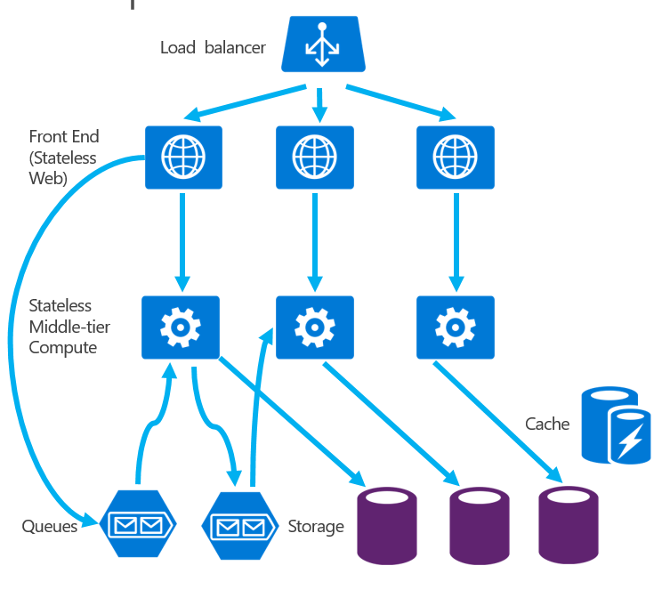
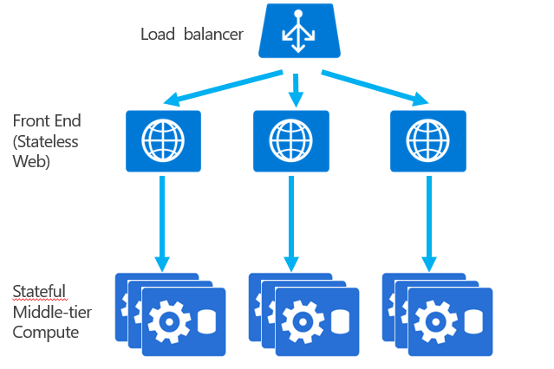
Stateless Services and Stateful Services
Stateless Services - no state is maintained in the service. ➔ Covered in this session
Stateful Services - state is stored with the service. ➔Not Covered in this session.
Stateless Services
Stateful Services
Notes:
Stateless Services - no state is maintained in the service. Longer term state is stored in an external database. This is your typical application/data layer approach to building services that you are already likely familiar with.
Stateful Services - state is stored with the service. Allows for state to be persisted with out the need for an external database. Data is co-located with the code that is running the service.

Slide 38
Conclusion
Microservices Overview
Introduction to Service Fabric and architecture
Prepare the environment
Demo:
Set up a local service Fabric Cluster
Create a Service Fabric using Visual Studio
Publish a Service Fabric in Visual Studio
Overview Monitoring and diagnostics
Build a .NET Service Fabric application
Deploy a Service Fabric application to a cluster in Azure
Build and execute Docker container in Service Fabric

Slide 39
References
https://www.linkedin.com/learning/l-essentiel-d-azure-service-fabric/
https://docs.microsoft.com/en-us/azure/service-fabric/service-fabric-tutorial-deploy-app-to-party-cluster
https://docs.microsoft.com/en-us/azure/service-fabric/service-fabric-tutorial-monitoring-aspnet
https://docs.microsoft.com/en-us/azure/service-fabric/service-fabric-overview
https://www.jamessturtevant.com/posts/Service-Fabric-Service-Types/

Slide 40

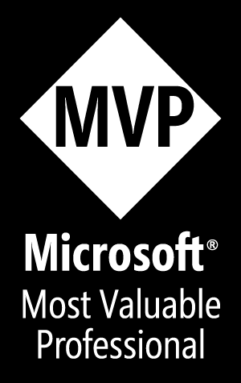
Hamida REBAI
Microsoft MVP
Merci
Merci
شكرا​

